Slide 1

Formatting
Clean Code – Chapter 5

Slide 2
Introduction
Clean, well-formatted code reflects professionalism and attention to detail. While messy code suggests carelessness throughout the entire project.
So,
you should take care that your code is nicely formatted.
choose a set of simple rules that govern the format of your code, and then you should consistently apply them.
If you are working on a team, then the team should agree to a single set of formatting rules.

Slide 3
The Purpose of Formatting
Code formatting is about communication, and communication is the professional developer’s first order of business.
The functionality you create today has a good chance of changing in the next release, but the readability of your code will have a profound effect on all the changes that will ever be made.
Your style and discipline survives, even though your code doesn’t.

Slide 4
Vertical Formatting – Introduction
How big are most Java source files?
It turns out that there’s a huge range of sizes and some remarkable differences in style.
There’s no absolute rule, keeping source files small (under 200-500 lines) makes code more manageable and easier to understand.

Slide 5
Vertical Formatting – The Newspaper Metaphor
We would like a source file to be like a newspaper article.
The name should be simple but explanatory.
The topmost parts of the source file should provide the high-level concepts and algorithms.
Detail should increase as we move downward, until at the end we find the lowest level functions and details.
If the newspaper were just one long story containing a disorganized agglomeration of facts, dates, and names, then we simply would not read it.

Slide 6
Vertical Formatting – Vertical Openness Between Concepts
Each group of lines represents a complete thought.
These thoughts should be separated from each other with blank lines
Each blank line is a visual cue that identifies a new and separate concept.

Slide 7
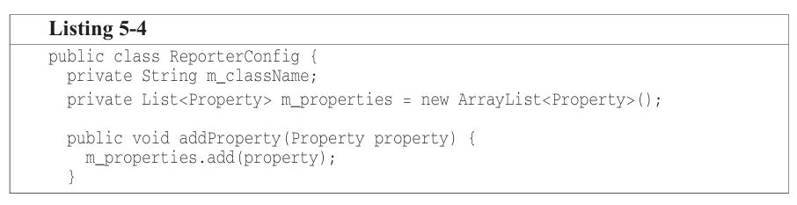
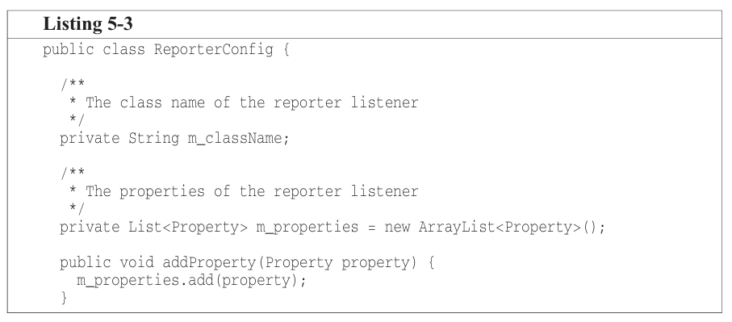
Vertical Formatting – Vertical Density
If openness separates concepts, then vertical density implies close association.
So, lines of code that are tightly related should appear vertically dense.

Slide 8
Vertical Formatting – Vertical Distance
Concepts that are closely related should be kept vertically close to each other.
This doesn’t work if concepts are separated into different files.
But related concepts shouldn’t be separated into different files, unless you have a good reason.
This one reason thar protected variables should be avoided.
So, closely related concepts should be placed near each other in the code to make it easier to understand without jumping around.

Slide 9
Vertical Formatting – Vertical Distance – Variable Declarations
Variables should be declared as close to their usage as possible.
Control variables for loops should be declared within the loop statement.
In rare cases, a variable might be declared at the top of a block or just before a loop in a long-ish function.

Slide 10
Vertical Formatting – Vertical Distance – Instance variables
On the other hand, should be declared at the top of the class.
This shouldn’t increase the vertical distance of these variables.
They should be declared in one well-known place.

Slide 11
Vertical Formatting – Vertical Distance – Dependent Functions
If one function calls another, they should be vertically close.
The caller should be above the callee, if at all possible.
This gives the program a natural flow.

Slide 12
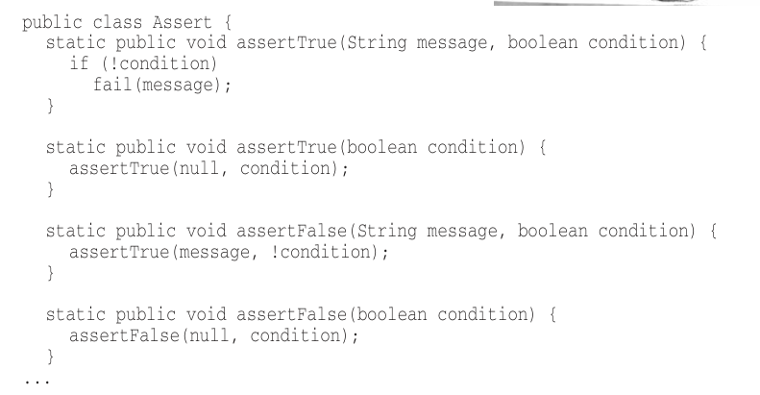
Vertical Formatting – Vertical Distance – Conceptual Affinity
Functions like assertTrue
and assertFalse in the Assert
class all deal with similar tasks,
use similar names, and follow
the same pattern. Even if they
don’t directly call each other,
they should still be placed close together in the code to make
it easier to understand and maintain.

Slide 13
Vertical Formatting – Vertical Ordering
In general, we want function call dependencies to point the downward direction.
That is, a function that is called should be below a function that does the calling.
We expect the low-level details to come last.
Notes:
Languages like Pascal, C, and C++ enforce functions to be defined, or at least declared, before they are used.

Slide 14
Horizontal Formatting – Introduction
Programmers clearly prefer short lines.
Old 80-character limit is somewhat outdated, lines up to 100-120 characters are acceptable.
It’s best to keep line length within a reasonable limit – for example, 120 characters.

Slide 15
Horizontal Formatting – Horizontal Openness and Density
We use white space to associate things that are strongly related and disassociate things that are more weakly related.
Space between the left and right side in the assignment statement accentuate them.
On the other hand, don’t put spaces between function names and the opening parenthesis as they are closely related.
Space is also used to accentuate the precedence of operators.

Slide 16
Horizontal Formatting – Horizontal Alignment
This kind of alignment isn’t useful.
The alignment seems to emphasize the wrong things and leads your eye away from the true intent.
If you have long lists that need to be aligned, the problem is the length of the lists, not the lack of alignment.

Slide 17
Horizontal Formatting – Indentation
A source file is a hierarchy rather than like an outline.
Individual classes within the file, methods within the classes, blocks within the methods, blocks within blocks.
To make this hierarchy visible, we indent the lines of source code in proportion to their position in the hierarchy.

Slide 18
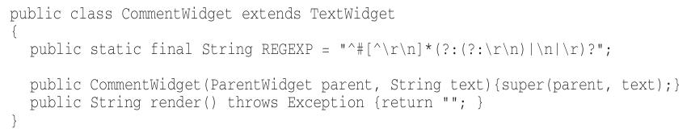
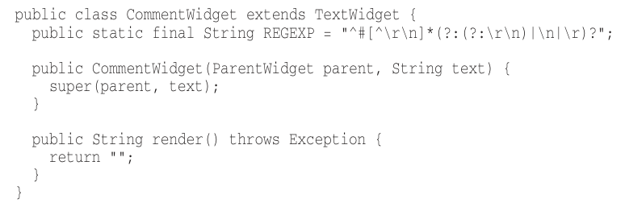
Horizontal Formatting – Indentation – Breaking Indentation
It’s sometimes tempting to break the indentation rule for short if statements, short while loops, or short functions.

Slide 19
Horizontal Formatting – Dummy Scopes
Sometimes the body of a while or for statement is a dummy.
It’s good to avoid this in general, but if you should do it, make sure that the dummy body is properly indented and surrounded by braces.

Slide 20
Team Rules
Every programmer has his own favorite formatting rules, but if he works in a team, then the team rules.
A team of developers should agree upon a single formatting style, and then every member should use that style.
A good software system is composed of a set of documents that read nicely.
The last thing we want to do is add more complexity to the source code by writing it in a jumble of different individual styles.

Slide 21
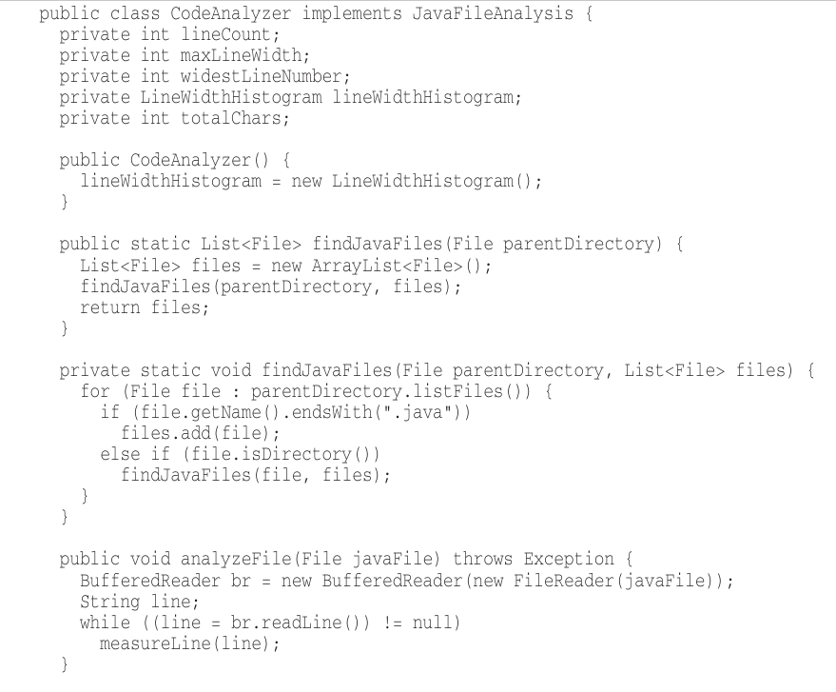
Uncle Bob’s Formatting Rules

Slide 22
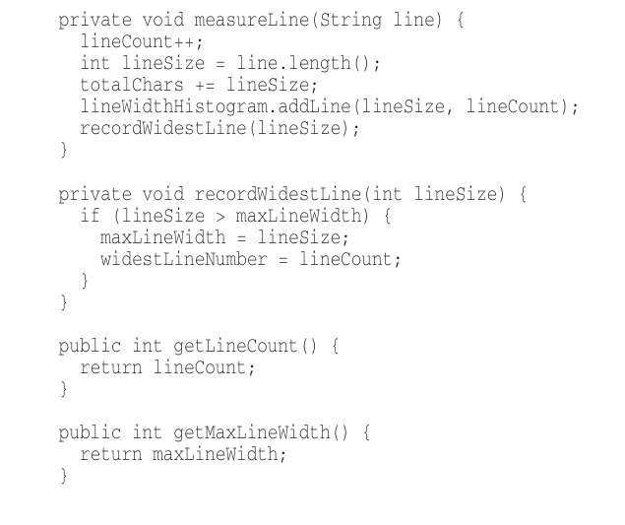
Uncle Bob’s Formatting Rules (cont.)

Slide 23
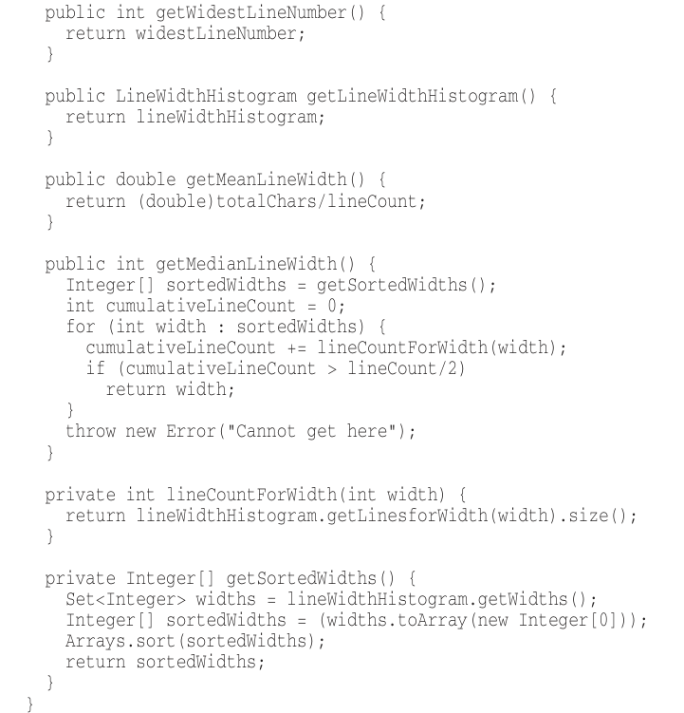
Uncle Bob’s Formatting Rules (cont.)

